Slide 1
Resource group
Subscription
al@amarlanda.com
AWS Account
automation-ps-rg
AWS Policy
Azure Automation Account
automation-ps-aa
AWS Tagging
Azure Runbook
Assets
Storing CMDB /

Slide 2
Types of runbooks
v
4 types of runbooks
Powershell workflow
Powershell workflow
Graphical powershell workflow

Slide 3
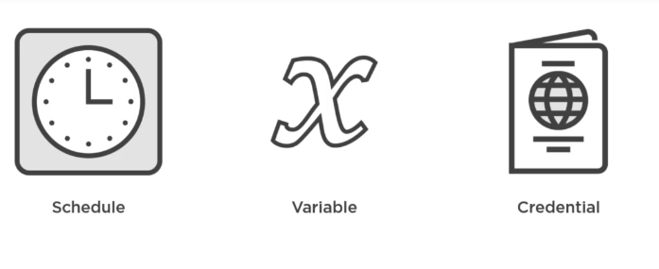
Types of assets
bla
Stores azure automation
Store passwords

